Slide 1

SKILL BRIDGE
Skill Development & Competency Management System
Connecting Learners with Skills, Knowledge and Opportunities.
Student Name : Preethi KN
Register Number: 240701398
Department: CSE
College Name : Rajalakshmi Engineering College
Academic Year : 2024 - 2028

Slide 2

One system, Every learning touchpoint.
SkillBridge centralizes skill development and competency management.
Course management, enrolment, payment, tutoring and an AI learning assistant come together in one coherent experience—simplifying operations for administrators and opening clearer pathways for learners.

Slide 3

From fragmented learning to one clear path
Fragmented resources
Complex enrolment
Limited tutor access
Delayed answers
→ One learning hub
→ Seamless automation
→ Integrated support
→ Instant AI guidance

Slide 4
Seven objectives. One connected experience.
1
2
3
4
Centralized
Course Management
Organized Categories
& Topics
Seamless Course
Enrolment
Learning Material
Management
5
6
7
Subscriptions
& Payments
Tutoring Requests
& Approvals
AI-Based Learning
Assistance

Slide 5
A decisive shift in how learning is managed
EXISTING SYSTEM
PROPOSED SKILLBRIDGE
— Disjointed platforms
✓ Unified platform
— Manual enrolment
✓ Automated enrolment & payment
— Limited support
✓ Integrated tutoring
— No AI assistance
✓ AI learning assistant

Slide 6
Built with low-code speed and AI intelligence
ZC
Zoho Creator
Application development
Zoho Creator
D
Deluge
Deluge
Workflow automation & logic
Forms · Reports · Pages
UI
Forms · Reports · Pages
Interface & data management
OpenAI API
AI
OpenAI API
Learning assistant integration

Slide 7
A layered architecture, designed to scale
USERS · Student | Tutor | Admin
INTERFACE · Pages | Forms | Reports
BUSINESS LOGIC · Deluge workflows
DATA · Courses | Enrolments | Payments | Tutoring
EXTERNAL INTEGRATION · AI Learning Assistant

Slide 8
Core modules that run the learning lifecycle
01
02
03
04
Add Course
Course Categories
Topic Management
Course Materials
Structure and maintain learning content.
Structure and maintain learning content.
Structure and maintain learning content.
Structure and maintain learning content.
05
06
07
08
User Enrolment
Course Subscription
Course Payment
Tutoring Management
Manage access, transactions and support.
Manage access, transactions and support.
Manage access, transactions and support.
Manage access, transactions and support.

Slide 9
The learner journey—from discovery to mastery
1
Access
2
Explore
3
Enrol
4
Materials
5
Pay
6
Tutoring
7
AI assist
Tutor · reviews requests
Admin · manages operations

Slide 10
Secure access, aligned to every role
ADMINISTRATOR
Read · Write
Platform control
TUTOR
Read · Write
Tutoring workflow
SKILLBRIDGE
STUDENT
Read · Write
Learning journey
Role-based permissions protect data while keeping each workflow focused and accountable.

Slide 11
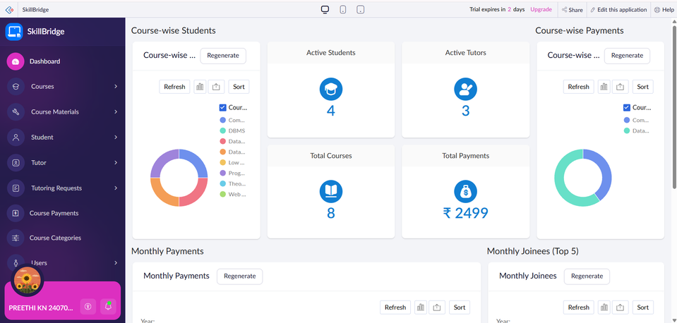
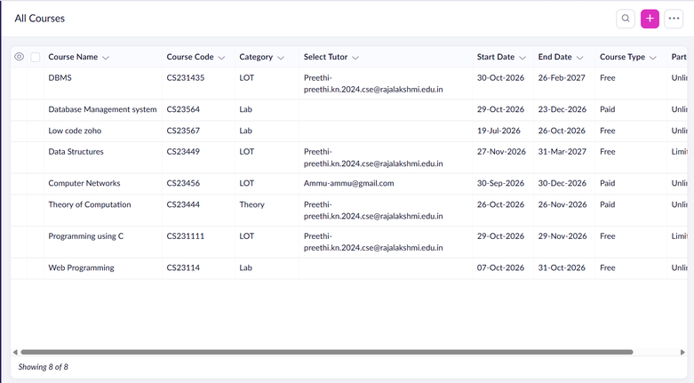
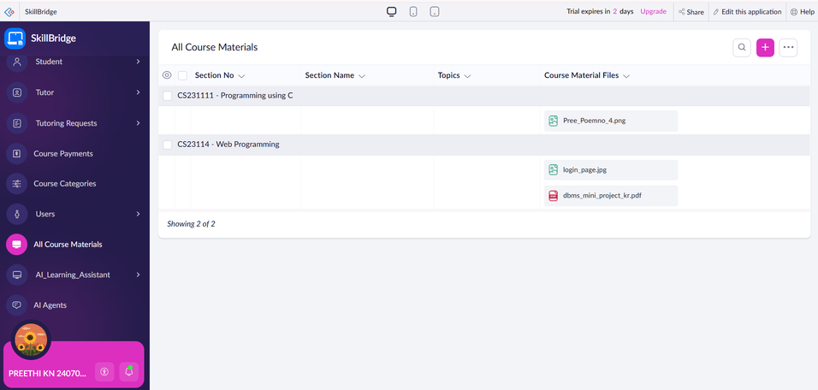
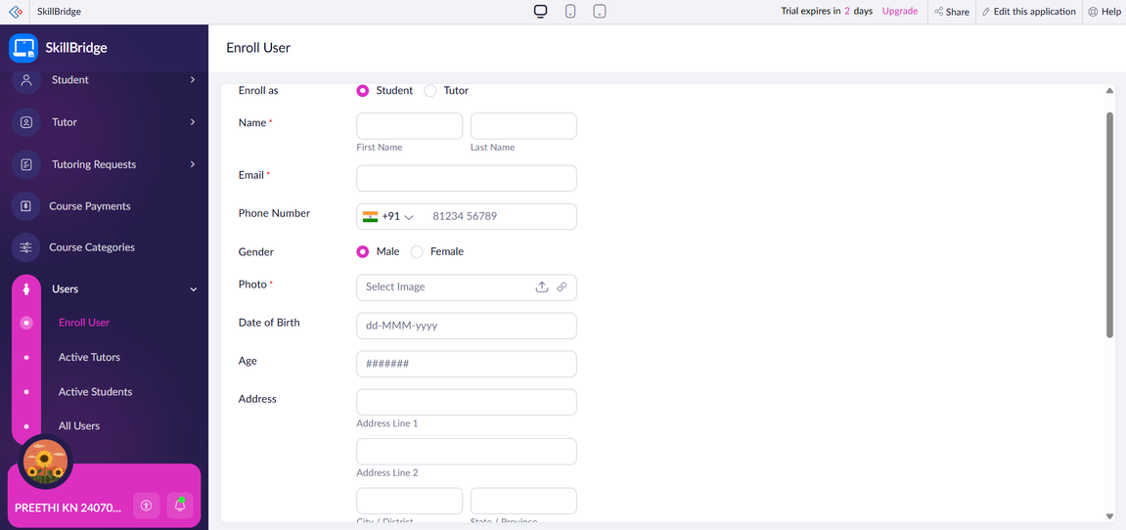
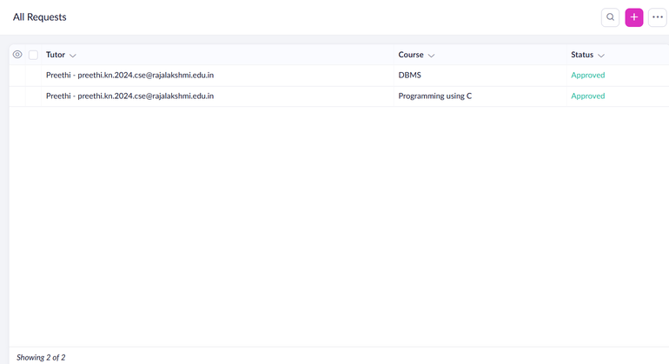
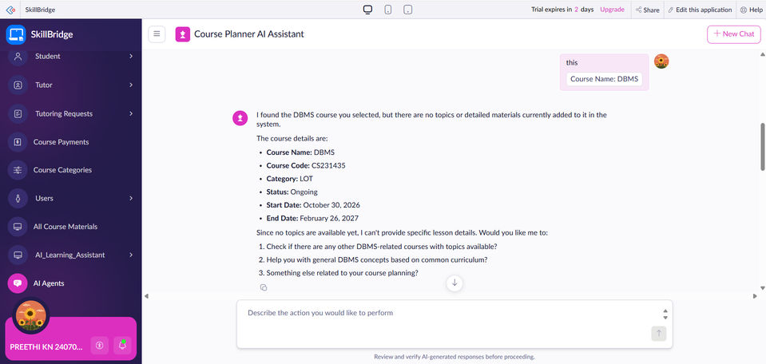
Application walkthrough
ADD SCREENSHOT
ADD SCREENSHOT
ADD SCREENSHOT
Home page
Course management
Course materials
ADD SCREENSHOT
ADD SCREENSHOT
ADD SCREENSHOT
Enrolment & subscriptions
Tutoring requests
AI Learning Assistant

Slide 12
Deluge workflow → AI-assisted answer
question = input.Question;
headers = Map();
headers.put("Content-Type","application/json");
payload = {"model":"assistant-model",
"prompt":question};
response = invokeurl
[
url : AI_ENDPOINT
type : POST
parameters : payload.toString()
headers : headers
];
input.Answer = response.get("result");
What it does
Captures a learner question, prepares the request payload, calls an AI endpoint and returns the generated response to the application.

Slide 13
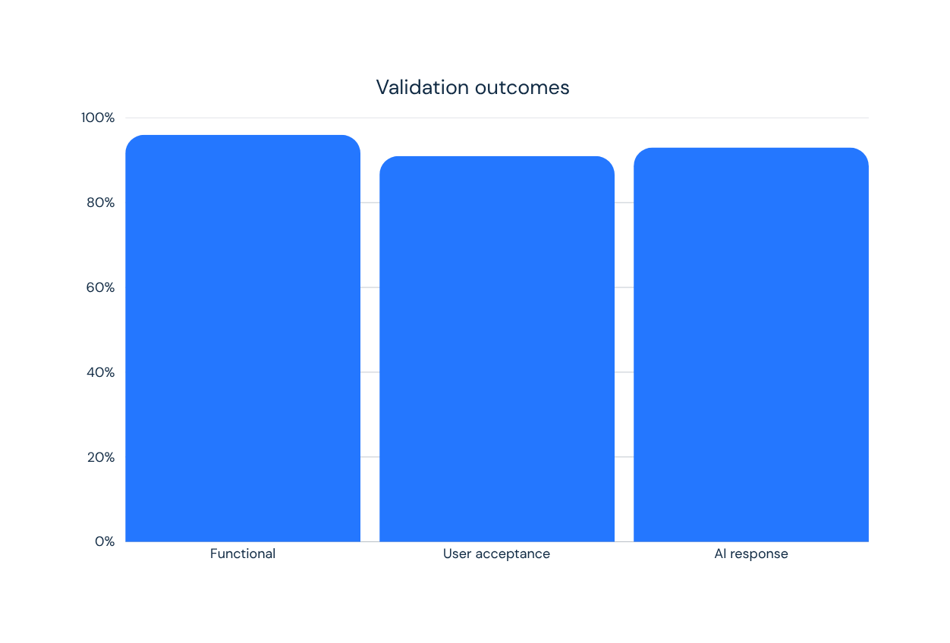
Testing confirms a stable, responsive experience
96%
Stable workflows
91%
Positive user feedback
93%
Responsive AI assistant

Slide 14
The bridge is built. Now learning can scale.
A unified platform for skill development, administration and intelligent learner support.
1
Progress tracking
2
Advanced analytics
3
Personalized recommendations
4
More AI-driven support
SKILLBRIDGE — Learn. Develop. Grow.
Thank You

